Slide 1
Time Management & Decisions in Hardware
Time Management, Boolean Logic and Functions Review, Implementing an Xor gate in HDL, Decisions in Hardware

Slide 2
Connect With Your CSE 390B Peers
Download Discord from https://discord.com/download
Log in or create an account
Click on icon in left-most column to create channel
Select “Create My Own”
Select “For me and my friends”
Give your server a name! (e.g., “CSE 390B 22au”)
Use the button to invite peers
Create some text and voice channels. Some ideas:
Text: #projects, #questions, #chill, #random
Voice: 🔊 Study Room, 🔊 Lounge
Feel free to connect via Slack, Messenger, etc. too

Slide 3
Lecture Outline
Time Management
Identifying Weekly Time Commitments
Review of Boolean Logic and Functions
Boolean Expressions, Circuit Diagrams, Truth Tables
Boolean Function Synthesis Strategy
Implementing an Xor gate in HDL
Applying the Boolean Function Synthesis Strategy
Making Decisions in Hardware
Multiplexer and Demultiplexer Logical Gate

Slide 4
Time Management
One of your most valuable resources in college is time
What typically fills up your time during the quarter?
Lectures, quiz sections, and attending office hours
Part-time jobs and working
Studying
Extracurricular activities or RSOs
Commuting
Chores at home
Socializing with friends and family
Physical, mental, spiritual activities

Slide 5
Weekly Time Commitments
Class meeting times and quiz sections
Family, friends, community, extracurricular commitments
Physical, mental, social, spiritual activities
Studying for each of your classes
The number of credits for a course reflects the number of hours the class meets
In general, courses require two hours of homework for every one hour of class
What else is not reflected given your specific situation?

Slide 6
Tracking Weekly Time Commitments
We often don’t realize what takes up our time until we manually track how we use our time
Exercise: Complete the weekly time commitments table
Tip: Use different colors for different activity types

Slide 7
Time Management Group Discussion
Now that you’ve filled out your weekly time commitments, discuss the following in groups for 4-6 minutes:
Did anything surprise you about the way you use your time?
What might you change about the way you utilize your time?
How could you use this time commitments sheet in the future?

Slide 8
Lecture Outline
Time Management
Identifying Weekly Time Commitments
Review of Boolean Logic and Functions
Boolean Expressions, Circuit Diagrams, Truth Tables
Boolean Function Synthesis Strategy
Implementing an Xor gate in HDL
Applying the Boolean Function Synthesis Strategy
Making Decisions in Hardware
Multiplexer and Demultiplexer Logical Gate

Slide 9
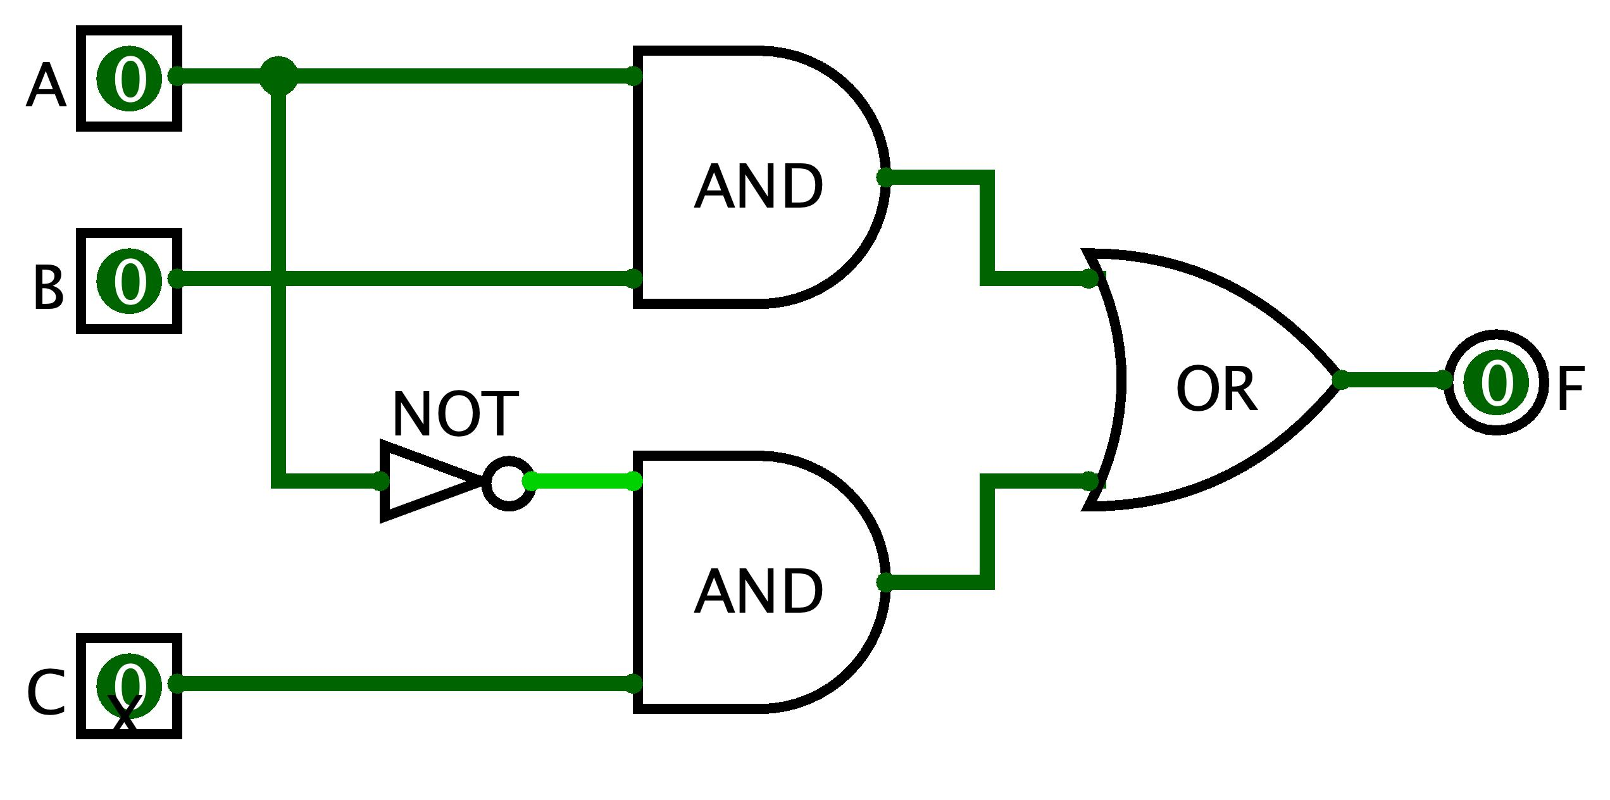
Boolean Functions
Combinations of Boolean inputs resulting in single output
Multiple ways to specify a Boolean function:
Boolean expression: F = (A AND B) OR (NOT(A) AND C)
Circuit diagram with logic gates:
Truth table:
A | B | C | F
0 | 0 | 0 | 0
0 | 0 | 1 | 1
0 | 1 | 0 | 0
0 | 1 | 1 | 1
1 | 0 | 0 | 0
1 | 0 | 1 | 0
1 | 1 | 0 | 1
1 | 1 | 1 | 1

Slide 10
Boolean Expression → Truth Table
We can build a truth table from an expression
Evaluate the Boolean expression on all possible inputs
F(A, B, C) = (A AND B) OR (NOT(A) AND C)
A | B | C | F
0 | 0 | 0
0 | 0 | 1
0 | 1 | 0
0 | 1 | 1
1 | 0 | 0
1 | 0 | 1
1 | 1 | 0
1 | 1 | 1

Slide 11
Boolean Expression → Truth Table
We can build a truth table from an expression
Evaluate the Boolean expression on all possible inputs
F(A, B, C) = (A AND B) OR (NOT(A) AND C)
A | B | C | F
0 | 0 | 0 | 0
0 | 0 | 1 | 1
0 | 1 | 0 | 0
0 | 1 | 1 | 1
1 | 0 | 0 | 0
1 | 0 | 1 | 0
1 | 1 | 0 | 1
1 | 1 | 1 | 1

Slide 12
Boolean Expression ← Truth Table
But can we do it in reverse?
F(A, B, C) = (A AND B) OR (NOT(A) AND C)
?
A | B | C | F
0 | 0 | 0 | 0
0 | 0 | 1 | 1
0 | 1 | 0 | 0
0 | 1 | 1 | 1
1 | 0 | 0 | 0
1 | 0 | 1 | 0
1 | 1 | 0 | 1
1 | 1 | 1 | 1

Slide 13
Boolean Expression ← Truth Table
Describe rows with an output of 1 using AND and NOT
Then, we can combine the rows using OR operations
F = NOT(A) AND NOT(B) AND C OR NOT(A) AND B AND C OR
A AND B AND NOT C OR A AND B AND C
A | B | C | F
0 | 0 | 0 | 0
0 | 0 | 1 | 1 | NOT(A) AND NOT(B) AND C
0 | 1 | 0 | 0
0 | 1 | 1 | 1 | NOT(A) AND B AND C
1 | 0 | 0 | 0
1 | 0 | 1 | 0
1 | 1 | 0 | 1 | A AND B AND NOT C
1 | 1 | 1 | 1 | A AND B AND C

Slide 14
Boolean Expression ← Truth Table
But can we do it in reverse?
Yes, we can! The strategy we used is Boolean Function Synthesis
F(A, B, C) = (A AND B) OR (NOT(A) AND C)
✓
A | B | C | F
0 | 0 | 0 | 0
0 | 0 | 1 | 1
0 | 1 | 0 | 0
0 | 1 | 1 | 1
1 | 0 | 0 | 0
1 | 0 | 1 | 0
1 | 1 | 0 | 1
1 | 1 | 1 | 1

Slide 15
Lecture Outline
Time Management
Identifying Weekly Time Commitments
Review of Boolean Logic and Functions
Boolean Expressions, Circuit Diagrams, Truth Tables
Boolean Function Synthesis Strategy
Implementing an Xor gate in HDL
Applying the Boolean Function Synthesis Strategy
Making Decisions in Hardware
Multiplexer and Demultiplexer Logical Gate

Slide 16
Project 2 Overview
Metacognitive Components
Part I: Study Skills Inventory — self-assessing your skill level in various study practices and habits
Part III: Project 2 Reflection — reflect on your experience working through the project
Technical Component
Part II: Boolean Logic — implement foundational Boolean logic gates (e.g., Not, And, Or, etc. gates)
Clone your GitLab repository, write and test your code
Project 2 due next Thursday (10/13) at 11:59pm

Slide 17
The Foundational Building Block
It all starts with the NAND gate
NAND is short for “Not And”
The same output as the AND gate, but every output bit is negated (flipped)
A | B | F
0 | 0 | 0
0 | 1 | 0
1 | 0 | 0
1 | 1 | 1
A | B | F
0 | 0 | 1
0 | 1 | 1
1 | 0 | 1
1 | 1 | 0

Slide 18
Building Gates From Nand
Recall the Boolean Function Synthesis strategy
We saw how we can represent any truth table in terms of three gates: Not, And, Or
First, we can represent Not directly from Nand
Not a = a Nand a
Then, we can represent And in terms of Not and Nand
a And b = Not(a Nand b)
Represent Or in terms of Not and And
Apply De Morgan’s Law
a Or b = Not(Not(a) And Not(b)) [De Morgan’s Law]

Slide 19
Implementing an Xor gate: Overview
Let’s walk through an example of building a gate that you will work on in Project 2, the Xor gate
Together, we’ll implement the Xor gate
/**
* Xor gate:
* out = not(a == b)
*/ CHIP Xor {
IN a, b;
OUT out;
PARTS:
// Put your code here:
}

Slide 20
Implementing an Xor gate: Overview
Plan of action:
Step 1: Create the logic operation’s truth table
Step 2: Use truth table to generate a Boolean function using strategies we’ve learned, such as the Boolean Function Synthesis
Step 3: Convert Boolean function to HDL
/**
* Xor gate:
* out = not(a == b)
*/ CHIP Xor {
IN a, b;
OUT out;
PARTS:
// Put your code here:
}

Slide 21
Implementing an Xor gate: Step 1
Step 1: Create the truth table for Xor
Interpret the specification: F = NOT(A == B)
A | B | F
0 | 0
0 | 1
1 | 0
1 | 1

Slide 22
Implementing an Xor gate: Step 1
Step 1: Create the truth table for Xor
Interpret the specification: F = NOT(A == B)
A | B | F
0 | 0 | 0
0 | 1 | 1
1 | 0 | 1
1 | 1 | 0

Slide 23
Implementing an Xor gate: Step 2
Step 2: Use truth table to generate a Boolean function
Let’s use the Boolean Function Synthesis strategy
Row 2 = NOT(A) AND B
A | B | F
0 | 0 | 0 | (Row 1)
0 | 1 | 1 | (Row 2)
1 | 0 | 1 | (Row 3)
1 | 1 | 0 | (Row 4)

Slide 24
Implementing an Xor gate: Step 2
Step 2: Use truth table to generate a Boolean function
Let’s use the Boolean Function Synthesis strategy
Row 2 = NOT(A) AND B
Row 3 = A AND NOT(B)
A | B | F
0 | 0 | 0 | (Row 1)
0 | 1 | 1 | (Row 2)
1 | 0 | 1 | (Row 3)
1 | 1 | 0 | (Row 4)

Slide 25
Implementing an Xor gate: Step 2
Step 2: Use truth table to generate a Boolean function
Let’s use the Boolean Function Synthesis strategy
Row 2 = NOT(A) AND B
Row 3 = A AND NOT(B)
F = ?
A | B | F
0 | 0 | 0 | (Row 1)
0 | 1 | 1 | (Row 2)
1 | 0 | 1 | (Row 3)
1 | 1 | 0 | (Row 4)

Slide 26
What is the unsimplified Boolean expression result from performing Boolean function synthesis on F = A XOR B?
(A AND NOT(B)) AND (NOT(A) AND B)
(NOT(A) AND B) AND (A AND B)
(A AND B) OR (NOT(A) AND NOT(B))
(NOT(A) AND B) OR (A AND NOT(B))
We’re lost…
A | B | F = A XOR B
0 | 0 | 0 | (Row 1)
0 | 1 | 1 | (Row 2)
1 | 0 | 1 | (Row 3)
1 | 1 | 0 | (Row 4)
Row 2 = NOT(A) AND B
Row 3 = A AND NOT(B)

Slide 27
Implementing an Xor gate: Step 2
Step 2: Use truth table to generate a Boolean function
Let’s use the Boolean function synthesis strategy
Row 2 = NOT(A) AND B
Row 3 = A AND NOT(B)
F = Row 2 OR Row 3
= (NOT(A) AND B) OR (A AND NOT(B))
A | B | F
0 | 0 | 0 | (Row 1)
0 | 1 | 1 | (Row 2)
1 | 0 | 1 | (Row 3)
1 | 1 | 0 | (Row 4)

Slide 28
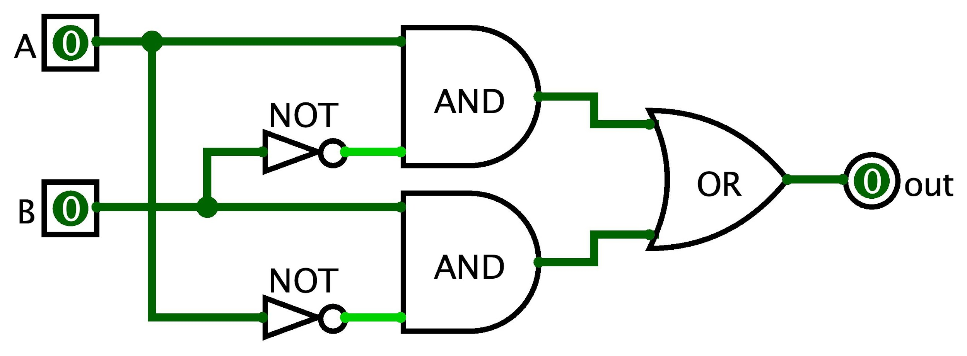
Implementing an Xor gate: Step 3
Now that we have a Boolean expression, we can implement the Xor gate in HDL
Optionally, it can help to express the Boolean expression as a circuit diagram
A XOR B = (NOT(A) AND B) OR (A AND NOT(B))

Slide 29
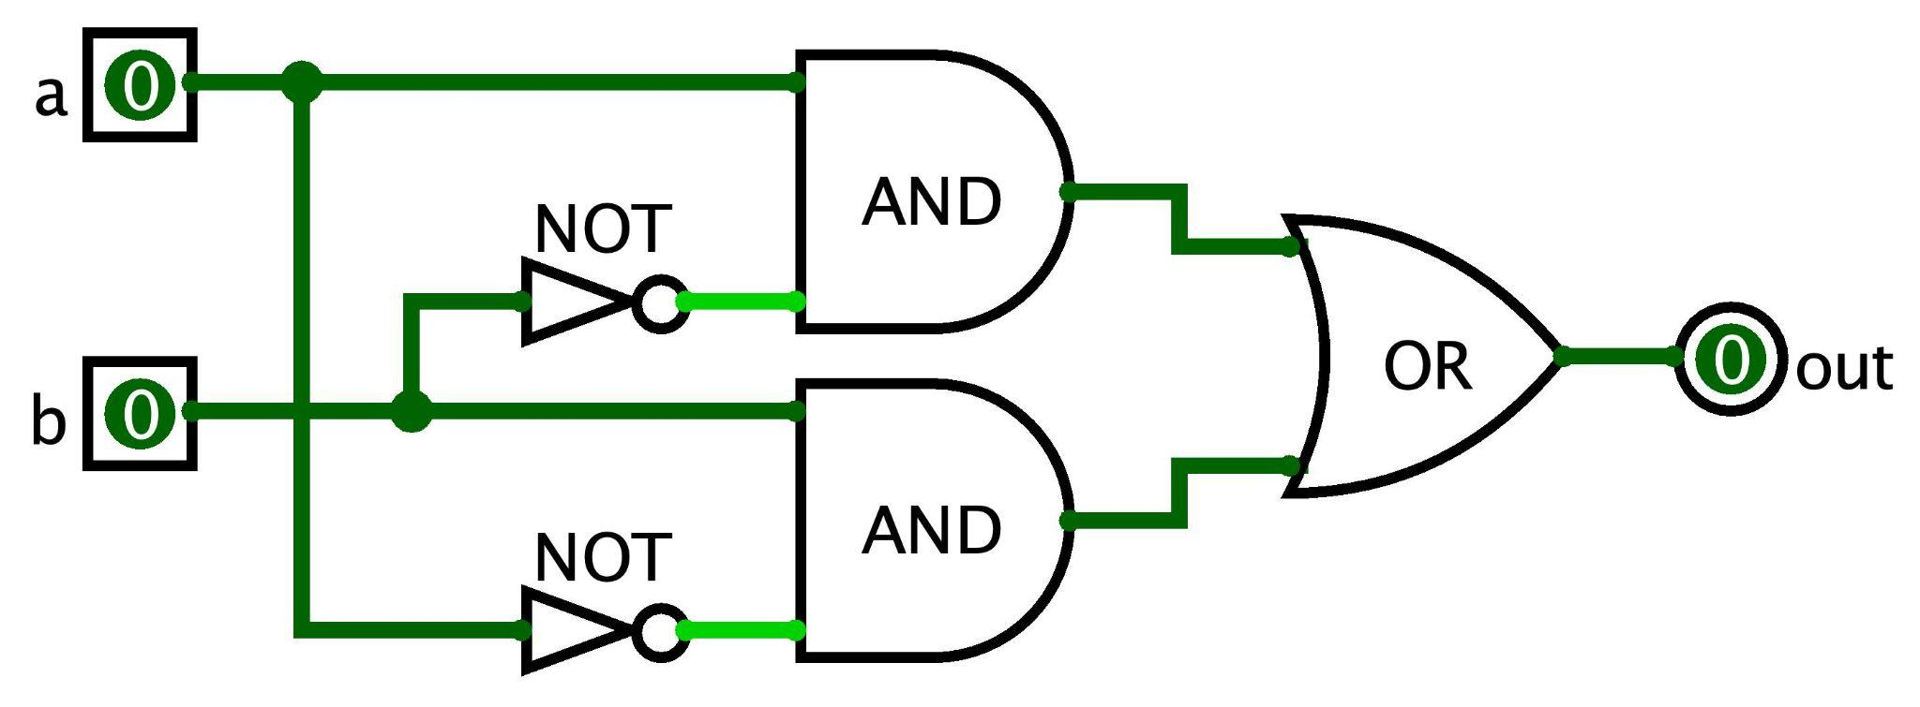
Implementing an Xor gate: Step 3
Step 3: Convert Boolean function to HDL syntax
A XOR B = (NOT(A) AND B) OR (A AND NOT(B))
Assumes Not, And, and Or are already implemented
Note the use of intermediary wires: nota, notb, x, and y
CHIP Xor {
IN a, b;
OUT out;
PARTS:
Not (in=a, out=nota);
Not (in=b, out=notb);
And (a=a, b=notb, out=x);
And (a=nota, b=b, out=y);
Or (a=x, b=y, out=out);
}

Slide 30
Lecture Outline
Time Management
Identifying Weekly Time Commitments
Review of Boolean Logic and Functions
Boolean Expressions, Circuit Diagrams, Truth Tables
Boolean Function Synthesis Strategy
Implementing an Xor gate in HDL
Applying the Boolean Function Synthesis Strategy
Making Decisions in Hardware
Multiplexer and Demultiplexer Logical Gate

Slide 31
Making Decisions in Hardware
We write if/else statements in Java with the understanding that only one of the branches will run
For example, in the following code, we expect to compute one of a & b or a | b (not both)
In hardware, the entire circuit is always executing
We can’t “turn off” a part of a circuit based on a condition
Instead, we create circuits for different conditions and choose which output based on a condition instead
if (c == 0) {
out = a & b;
} else {
out = a | b;
}

Slide 32
Decisions in Hardware: Mux Gate
We can use a Multiplexer (Mux) gate to choose which singular input to output
Takes three inputs: a, b, and sel
If sel == 0, then out = a
Otherwise, out = b
Mux Gate Truth Table:
a
0
Mux
out
b
1
sel
a | b | sel | F
0 | 0 | 0 | 0
0 | 0 | 1 | 0
0 | 1 | 0 | 0
0 | 1 | 1 | 1
1 | 0 | 0 | 1
1 | 0 | 1 | 0
1 | 1 | 0 | 1
1 | 1 | 1 | 1

Slide 33
Decisions in Hardware: DMux Gate
A Demultiplexer (DMux) gate passes one input to one of two outputs and 0 to the rest
Takes two inputs: in and sel
If sel == 0, then a = in and b = 0
Otherwise, a = 0 and b = in
DMux Gate Truth Table:
a
0
in
DMux
1
b
sel
in | sel | a | b
0 | 0 | 0 | 0
0 | 1 | 0 | 0
1 | 0 | 1 | 0
1 | 1 | 0 | 1

Slide 34
Example of Applying the Mux Gate
Draw the circuit diagram that corresponds to the following pseudocode:
if (sel == 0) {
out = ~a | ~b;
} else {
out = a | b;
}

Slide 35
Implementation a Mux and DMux Gate
We can follow the same process as implementing an Xor gate from earlier
Plan of action:
Step 1: Create the logic operation’s truth table
Step 2: Use truth table to generate a Boolean function using strategies we’ve learned, such as the Boolean Function Synthesis
Step 3: Convert Boolean function to HDL
Exercise for you to practice in Project 2

Slide 36
Post-Lecture Reminders
Project 1 due tonight (10/6) at 11:59pm
Project 2 (Study Skills Inventory & Boolean Logic) released today, due next Thursday (10/13)
Course Staff Support
Eric has office hours in CSE2 153 today after lecture
Post your questions on the Ed discussion board

